Slide 1
Raven Hawk
An American Fiction Writer and Poet

Slide 2
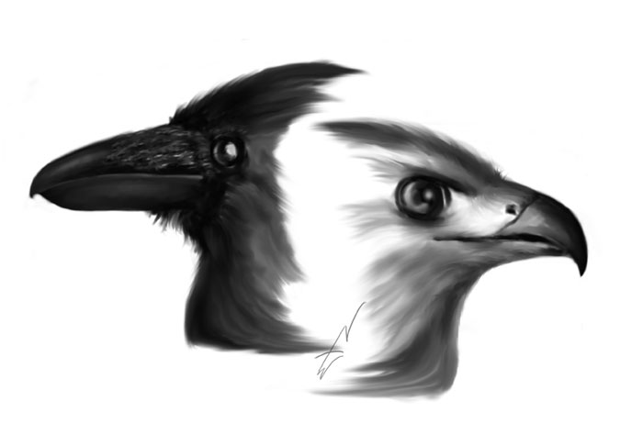
Raven Hawk

Slide 3
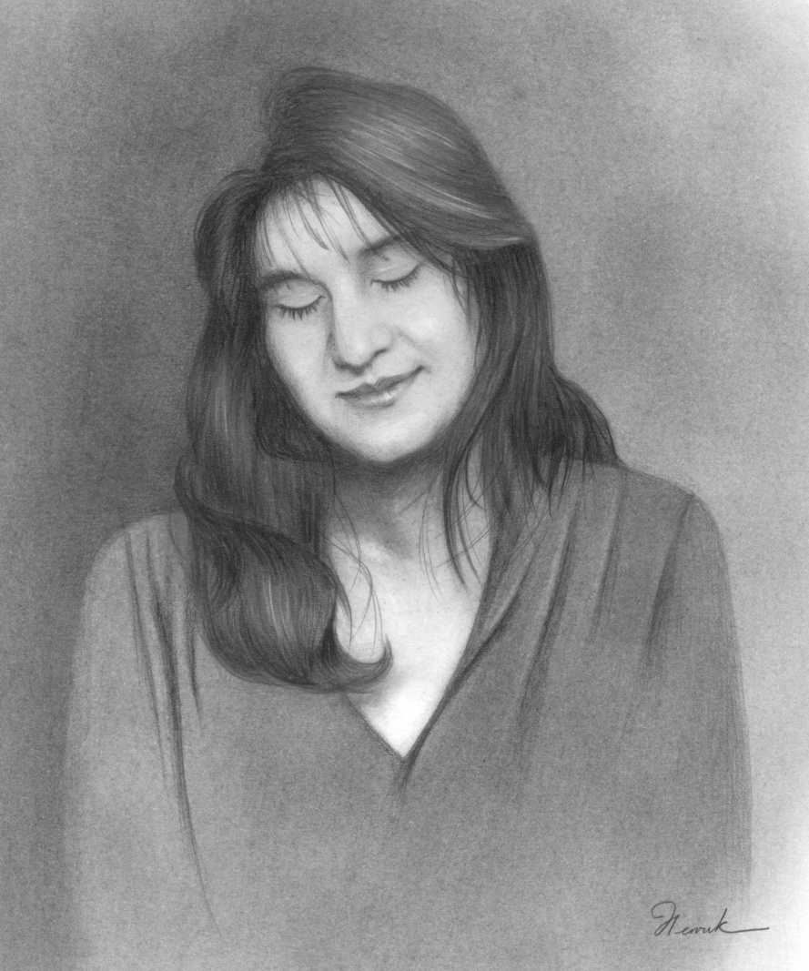
Raven Hawk
I am an American fiction writer and poet living in Central Vermont. I am currently pursuing a Bachelors Degree in English and Creative Writing, with a specialization in Fiction, at Southern New Hampshire University where I expect to graduate in the fall of 2017. While attending classes, I also work as a Personal Advocate and Mediator for low-income families in the Central Vermont area and I am on the editorial staff of VIMFIREmagazine (www.vimfiremagazine.com). When time permits, I enjoy editing manuscripts for other aspiring writers.

Slide 4
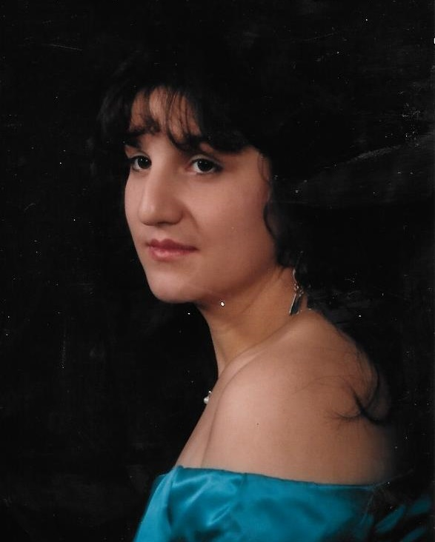
Raven Hawk
My Goals As A Writer
I want to write stories that show people on an intimate level, and in a powerful and personal way.
I want to use my stories to make a positive difference in the lives of others.
I want to write books that help people explore their true identity, beliefs, and feelings to help them have the courage to stand up to external pressures with honesty and conviction.

Slide 5
Raven Hawk
The Writer
Weather Permitting (excerpt)
Amara woke that late October morning to a deep darkness. It was as if someone had turned the lights out on the entire world. The whole house seemed unnaturally quiet, in that creepy way horror movies are calm just before the maiming begins. The alarm clock flashed on the nightstand, screaming silently for her attention. It told her to wake up, to run away, and to hide - but it would not tell her the time. Nevertheless, it did confirm her suspicions about the state of the electricity.
She eased out of bed slowly, hoping not to wake him, and inched over to the bedroom windows - grabbing her robe off the bedpost as she went. Once there, she peeked through the curtains with two fingers, as one might through mini-blinds when desiring to see the world outside but not be seen by it. The entire street was shrouded in darkness so thick that it practically suffocated all attempts for light to break through. The only exception was a handful of small hazy illuminations, spaced evenly apart along the street. They appeared to be nothing more than ghostly orbs lingering on the edge of daybreak.
Shivering, Amara pulled on her robe and wrapped it tightly around her thin waist, tying it with a large loose bow. She started for the door, but stopped to look back for one brief moment. Once assured that he was still asleep, she turned the knob slowly. Even though it creaked as it opened, the door still provided an adequate escape from the light deprived bedroom. She eased her way down the stairs as quickly and quietly as she could, pausing only briefly to calm her own breathing. As she crept through the sleeping house, Amara smirked to herself at the thought of how odd it seemed to think of this cage as a home.
I write about …
struggle, in order to show hope
pain and loss, in order to show love and beauty in small moments
fear, in order to show that even those seen as weak and small can have amazing strength and courage in their own way
domestic violence, to show the complicated struggle of being in such relationships, as well as leaving them

Slide 6
Raven Hawk
The Poet
Bliss
Oh, how I ache for you.
I see you there,
across the room – with her.
You call to me without a word.
I avoid you.
Circling the edge of the party,
there is casual conversation and meaningless words.
I only care for you.
I only came for you,
but I stay away because you are not mine.
You are hers,
and if I were to hold you now,
to even be close enough to touch -
I might behave disgracefully.
The time has come.
The toast.
The cheers.
I debate if I dare,
Then I take a slice.
After all – how can I refuse
Chocolate Cake!
I write a lot of poetry, and I publish approximately one third of my new poems on my blog (www.myravenquill.com).
The poems are there for the public to read and review at will. I love to hear people’s comments and suggestions.
At this time, I have no intention of publishing, traditionally or otherwise, a book of poetry. However, I do occasionally put some of my poems in my other work, which is why I do not currently post more of my poems on my blog.

Slide 7
Raven Hawk
Praise for ‘Carly’
Praise for ‘The Picnic’
“Raven Hawk has emotions running high, as she draws you in on an unexpected ride through the inner turmoil of a young woman who just wants to belong.” - Amber E. Box
“A coming-of-age story changes Carly in unexpected ways–in ways she herself doesn’t realize, leaving Raven Hawk’s reader with the urge to pick up the phone and tell friends and family just how much they’re cherished. Relatable characters and compelling dialogue will draw in anyone who picks up Carly.” - Margaret McNellis, Author of A Modern Masquerade
“In a short span, Raven Hawk manages to connect with the audience on multiple levels, taking them on an emotional journey that is both powerful and relatable as they sit down to The Picnic.” - Amber E. Box
“Raven Hawk turns the simple innocence of a picnic into a deep, emotional, heart-in-throat experience that will stay with readers long after reading the short story.” - Margaret McNellis, Author of A Modern Masquerade

Slide 8
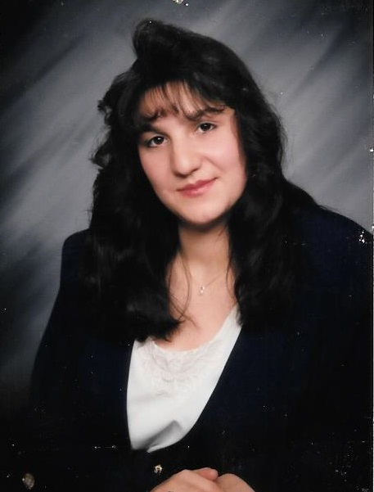
Raven Hawk
Where To Find Me Online
& How To Contact Me:
Website: www.myravenquill.com
Facebook:
www.facebook.com/MyRavenQuill
Twitter: @MyRavenQuill
Email: myravenquill@gmail.com

Slide 9

The End

